Slide 1

ANALYSIS
WORLD OIL AND GAS INDUSTRY PERFORMANCE
Ghassan Belaish
Ghassanbelaish@gmail.com

Slide 2

World Oil and Gas Industry Performance Analysis
Objective: Analyze the relationship between oil production volumes, reserves, and natural resource rents across major producing nations
Scope: Global analysis from 1970-2025
Focus Areas:Production trends and growth patterns
Reserve management strategies
Economic impact through natural resource rents
Comparative analysis of top producers
Talbleau link (klick here)

Slide 3


Findings

Slide 4
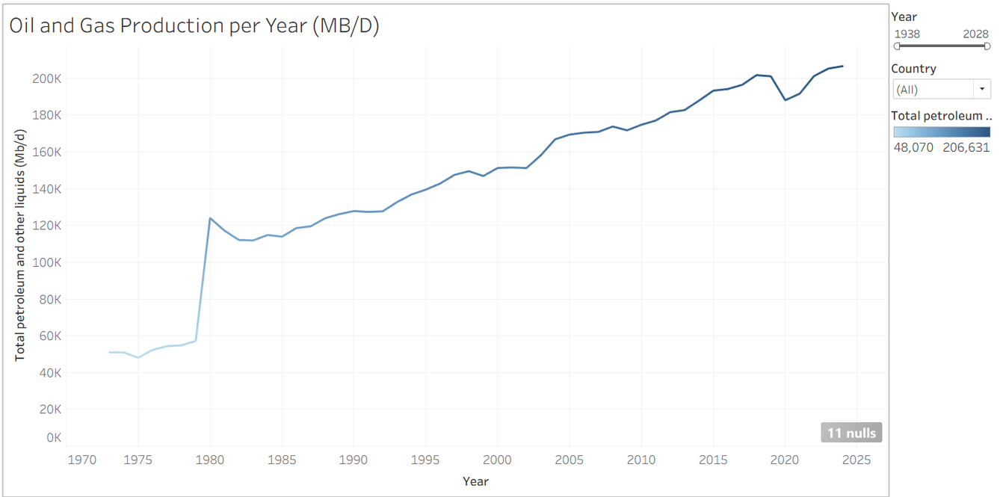
The Production Surge:
A 50-Year Transformation
Global oil production has MORE THAN DOUBLED since 1970, reaching over 200,000 MB/D by 2025
Key Statistics:
1970s Baseline: ~50,000 MB/D
1980 Jump: Sharp increase to ~120,000 MB/D
2025 Peak: Over 200,000 MB/D
Growth Rate: 300%+ increase over 5 decades

Slide 5
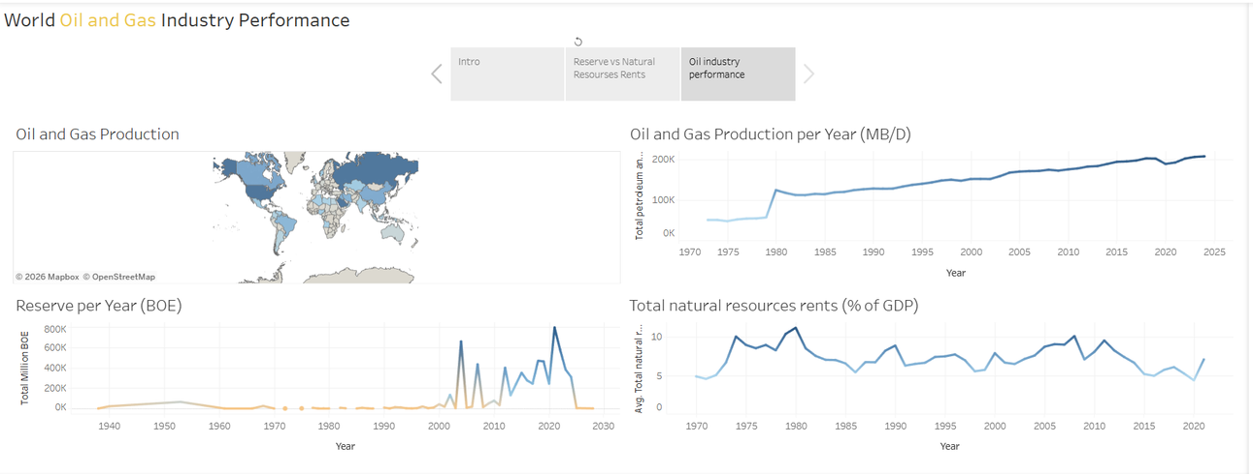
The Production-Reserve-Rent Relationship
Production ≠ Reserve Depletion
Countries with high production can maintain or grow reserves through:
New discoveries
Technology improvements
Enhanced recovery methods

Slide 6
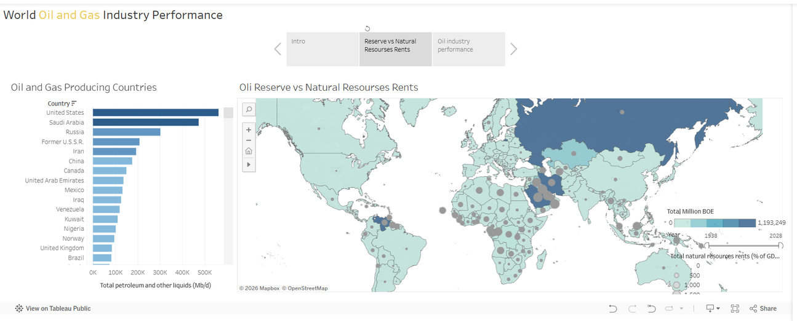
The Production-Reserve-Rent Relationship
Natural Resource Rents as % of GDP Varies Dramatically
High Dependency Countries: 10-20% of GDP (Russia, Middle East)
Moderate Dependency: 5-10% of GDP
Diversified Economies: <5% despite high production (USA)

Slide 7
The Production-Reserve-Rent Relationship
Natural Resource Rents as % of GDP Varies Dramatically
High Dependency Countries: 10-20% of GDP (Russia, Middle East)
Moderate Dependency: 5-10% of GDP
Diversified Economies: <5% despite high production (USA)

Slide 8
Country-Specific Patterns:
Russia
Individual Countries
Production: ~10,000 MB/D (stable growth)
Natural Resource Rents: 10-20% of GDP
Reserves: Sharp increase post-2010
Shows volatility in rents despite stable production
Reserve fluctuations based on investment cycles

Slide 9
World Oil Industry: A Multi-Speed Landscape
Overall Performance Metrics:
Production Trends:
Global Total: 200,000+ MB/D (2025)
Growth Pattern: Steady increase with periodic plateaus
Recent Trend: Slowing growth rate despite absolute increases
Reserve Trends:
Volatility: Significant fluctuations post-2000
Peak Periods: Early 2000s, 2010s, 2020s
Pattern: Reserves respond to price cycles and investment
Economic Impact:
Natural Resource Rents: Fluctuating between 5-10% globally
Peak Rents: ~1980 (oil crisis era)
Recent Trend: Declining rent percentages despite higher production
Key Insight:Higher production volumes don't automatically translate to higher economic rents

Slide 10
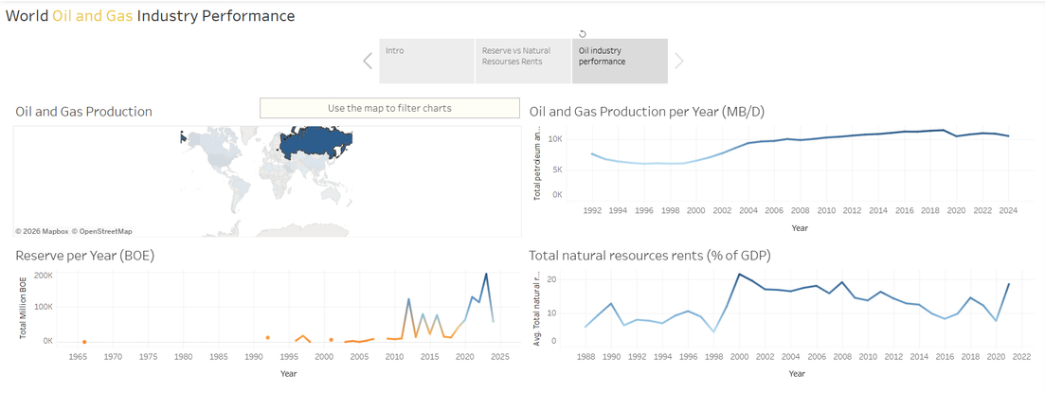
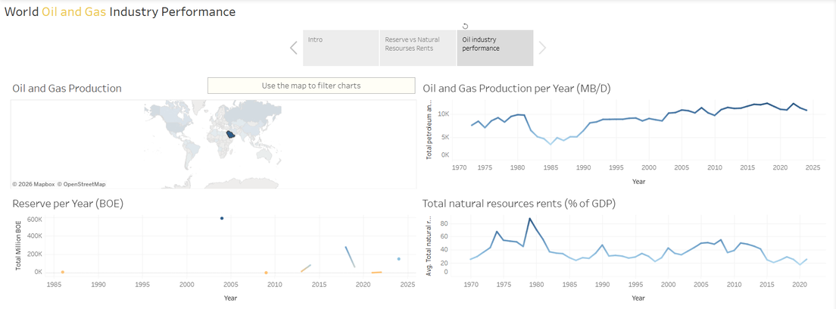
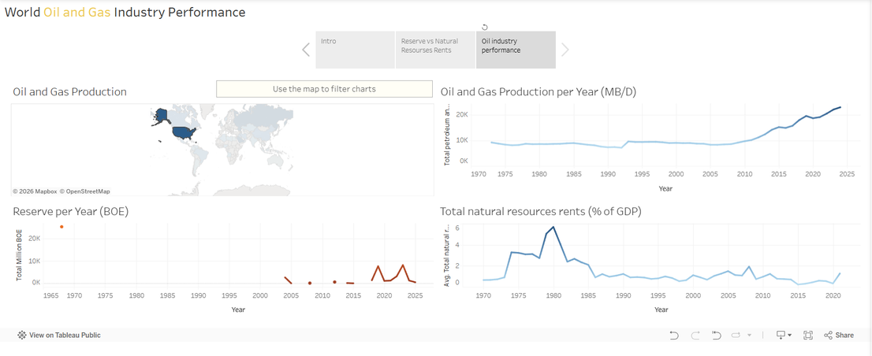
The Big Three: Common Strategies, Different Outcomes
Production Rankings
United States: ~500K MB/D
Saudi Arabia: ~450K MB/D
Russia: ~300K MB/D

Slide 11
The Big Three: Common Strategies, Different Outcomes
What They Have in Common:
2. Strategic Reserve Management
All three maintain significant proven reserves
Active investment in exploration and technology
Use reserves as geopolitical and economic tools
3. Economic Dependence (But Varying Degrees)
Russia: High dependence (10-20% of GDP from natural resource rents)
Saudi Arabia: High dependence (similar profile)
USA: Lower dependence (<5% despite highest production) due to diversified economy
4. Production Growth Trajectories
USA: Shale revolution drove massive growth
www.forbes.com
Saudi Arabia: Maintained steady high production
interfax.com
Russia: Stable growth post-1990s

Slide 12
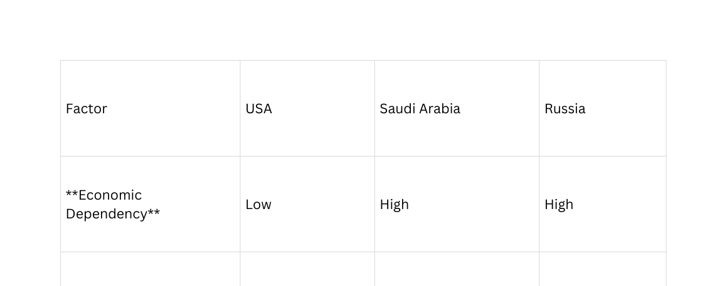
The Big Three: Common Strategies, Different Outcomes
What They Have in Common:
Key Differences Di?fferencedd
2. Strategic Reserve Management
All three maintain significant proven reserves
Active investment in exploration and technology
Use reserves as geopolitical and economic tools
3. Economic Dependence (But Varying Degrees)
Russia: High dependence (10-20% of GDP from natural resource rents)
Saudi Arabia: High dependence (similar profile)
USA: Lower dependence (<5% despite highest production) due to diversified economy
4. Production Growth Trajectories
USA: Shale revolution drove massive growth
www.forbes.com
Saudi Arabia: Maintained steady high production
interfax.com
Russia: Stable growth post-1990s

Slide 13
For High-Production Countries:
Diversify Economic Base
Challenge: High natural resource rent dependency creates vulnerability
Action: Follow USA model - high production with low GDP dependency
Target: Reduce natural resource rents to <10% of GDP while maintaining production
2. Invest in Reserve Sustainability
Challenge: Production growth must be balanced with reserve replacement
Action:Increase exploration investment
Adopt enhanced recovery technologies
Develop unconventional resources
3. Optimize Production Efficiency
Challenge: Maintaining competitiveness amid volatile prices
Action:Leverage technology for cost reduction
Improve operational efficiency
Focus on high-margin assets

Slide 14
For Industry Stakeholders:
Prepare for Demand Uncertainty
Global oil demand growth slowed to 0.8% in 2024
www.iea.org
Focus on quality over quantity
Develop flexible production capabilities
Strengthen Reserve Management
Implement dynamic reserve assessment
Balance short-term production with long-term sustainability
Monitor rent-to-production ratios

Slide 15
Next steps

Slide 16
Next Steps:
Conduct country-specific deep-dive analysis
Develop scenario planning for demand transitions
Create implementation roadmaps for recommendations
Establish monitoring frameworks for key metrics

Slide 17

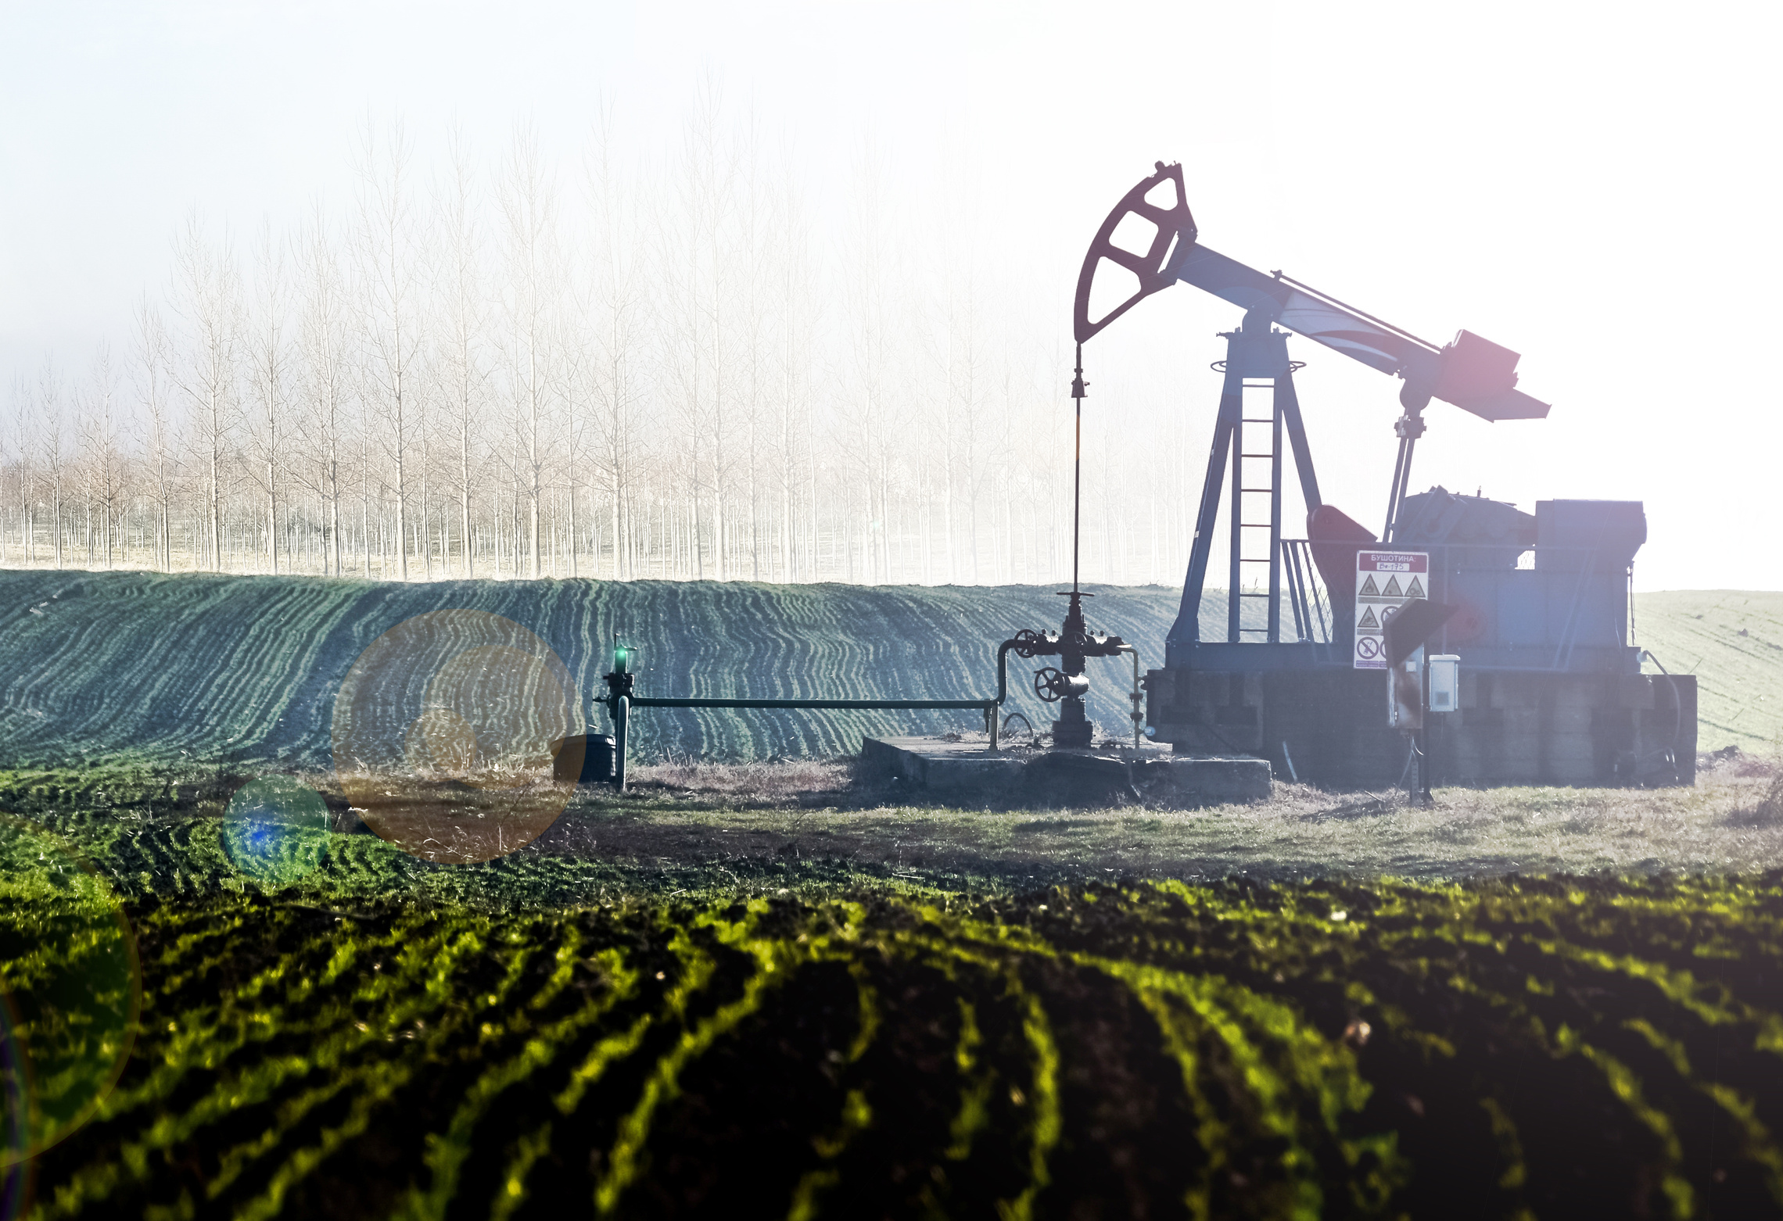



About Us
Ghassan Belaish
Sanaa - Yemen
+967-772002117
ghassanbelaish@gmail.com
We look forward to engaging with you and exploring opportunities for collaboration.

